Slide 1


Week 3 Intro to JavaScript
Nashau FESD

Slide 2


This week:
Arrays
Array methods
String methods
Functions
Objects

Slide 3
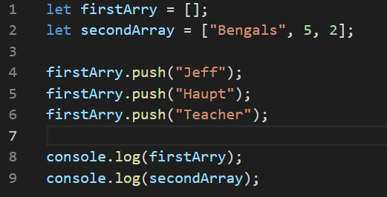
Arrays
Creating an array:

Slide 4
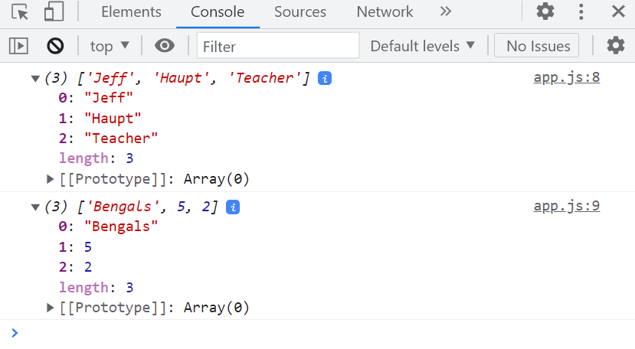
Arrays
Creating arrays

Slide 5
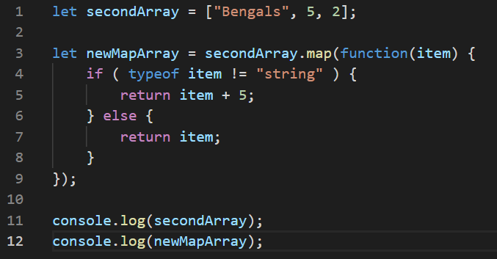
Array Methods
Map

Slide 6
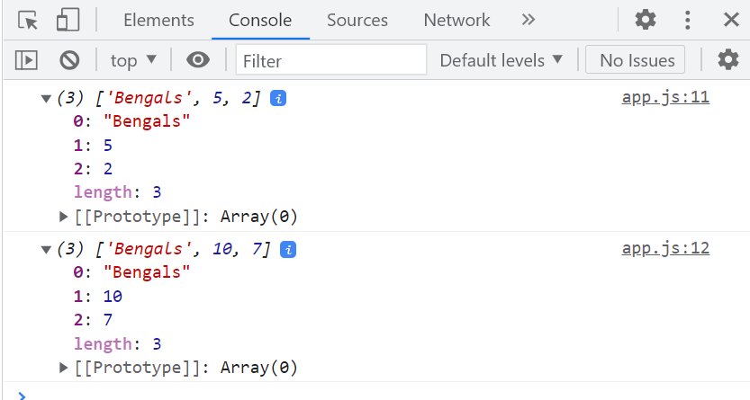
Array Methods
Map results

Slide 7
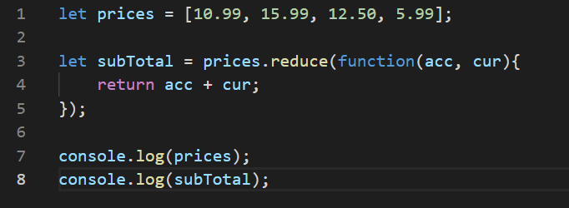
Array Methods
Reduce

Slide 8
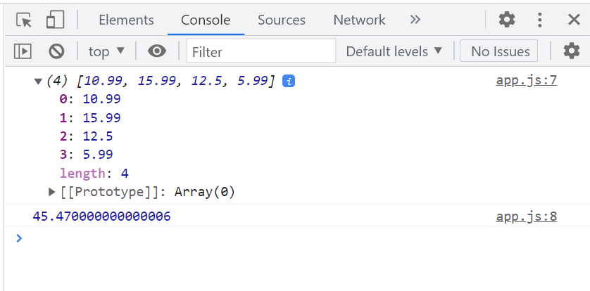
Array Methods
Reduce results

Slide 9
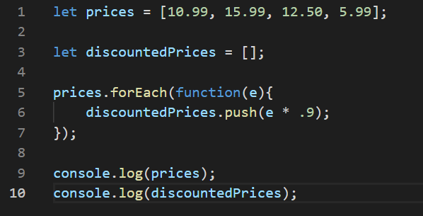
Array Methods
forEach

Slide 10
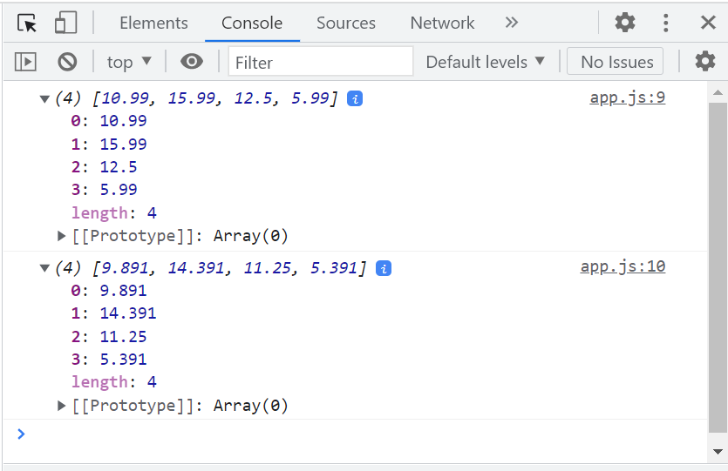
Array Methods
forEach results

Slide 11
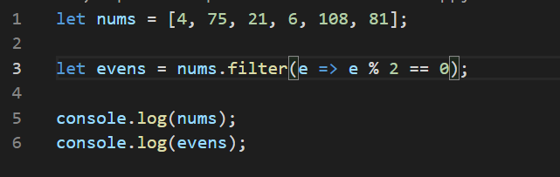
Array Methods
Filter

Slide 12
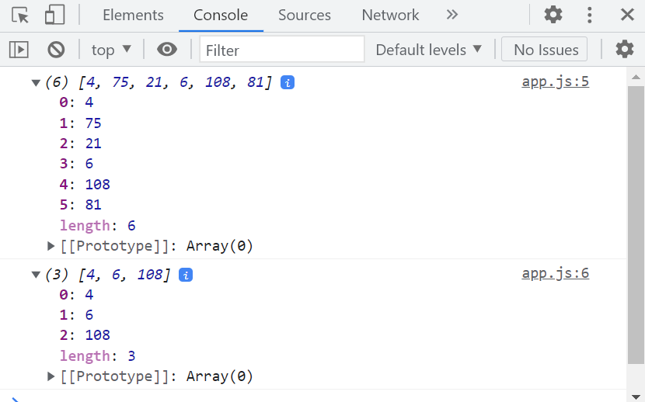
Array Methods
Filter results

Slide 13
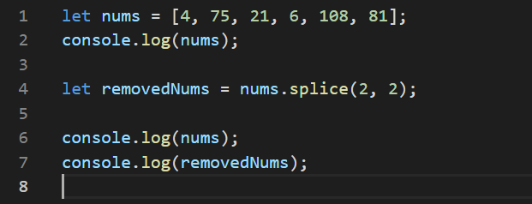
Array Methods
Splice

Slide 14
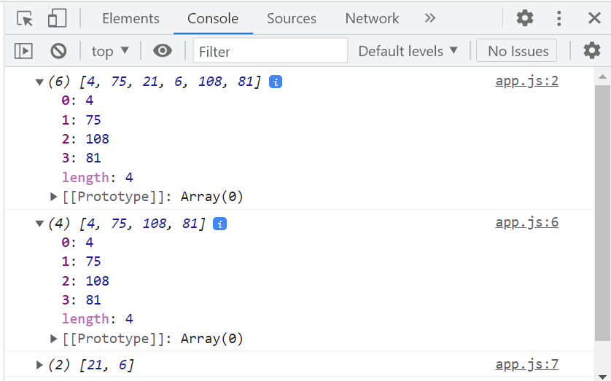
Array Methods
Splice results

Slide 15
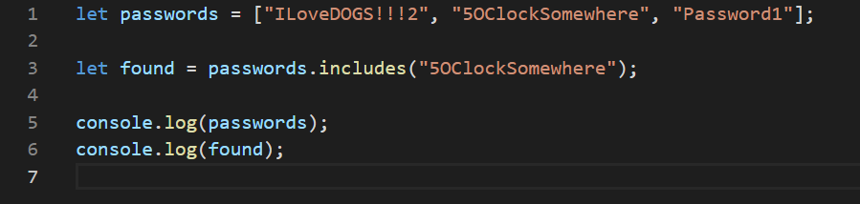
Array Methods
Includes

Slide 16
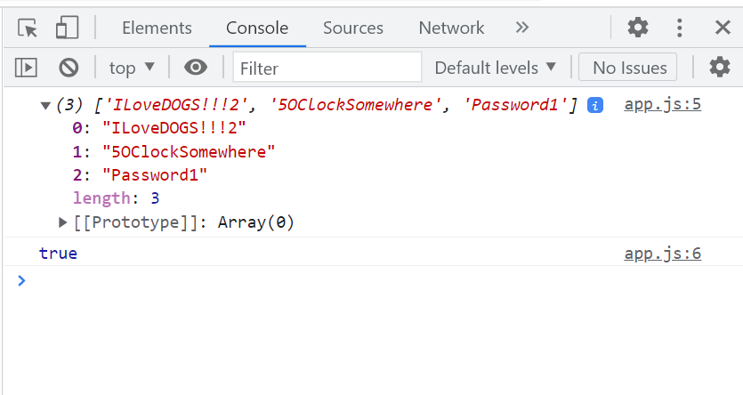
Array Methods
Includes results

Slide 17
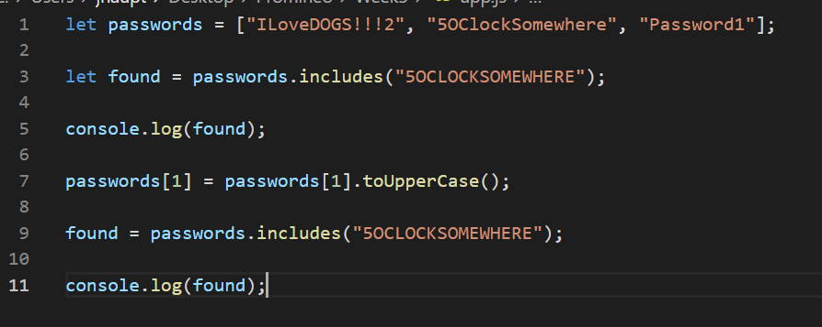
String methods
toUpperCase()
toLowerCase()

Slide 18
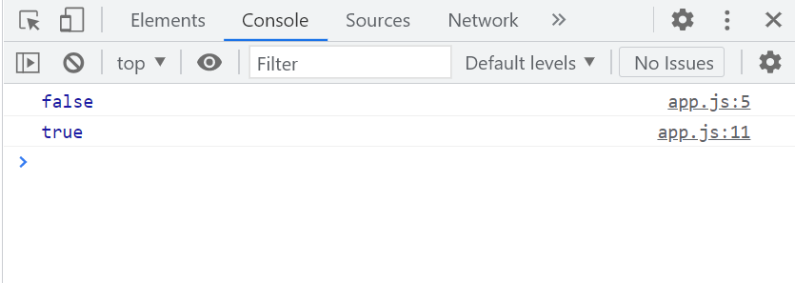
String methods
toUpperCase()
toLowerCase()

Slide 19
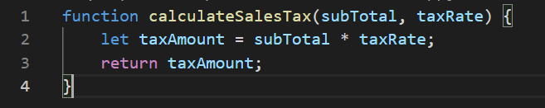
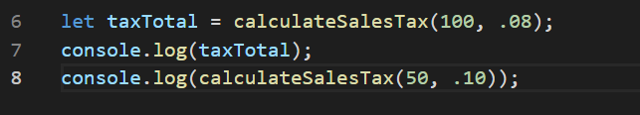
Functions
Creating a function:
Calling function:

Slide 20
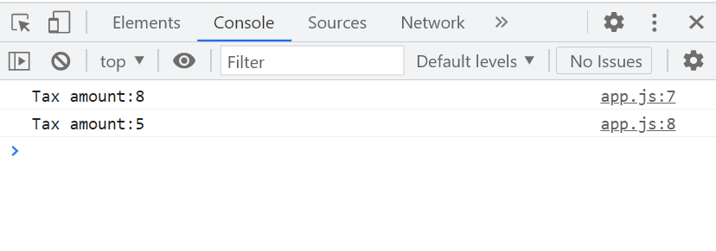
Functions
Creating and calling functions

Slide 21
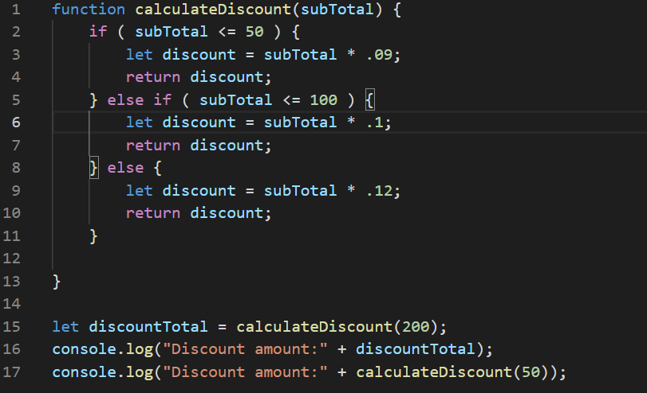
Functions and Returns
Using multiple return statements in a function

Slide 22
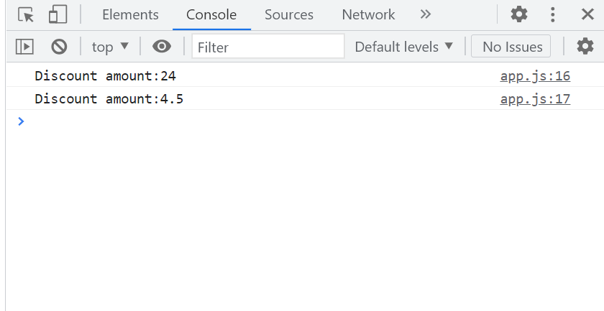
Functions and Returns
Multiple return statements

Slide 23
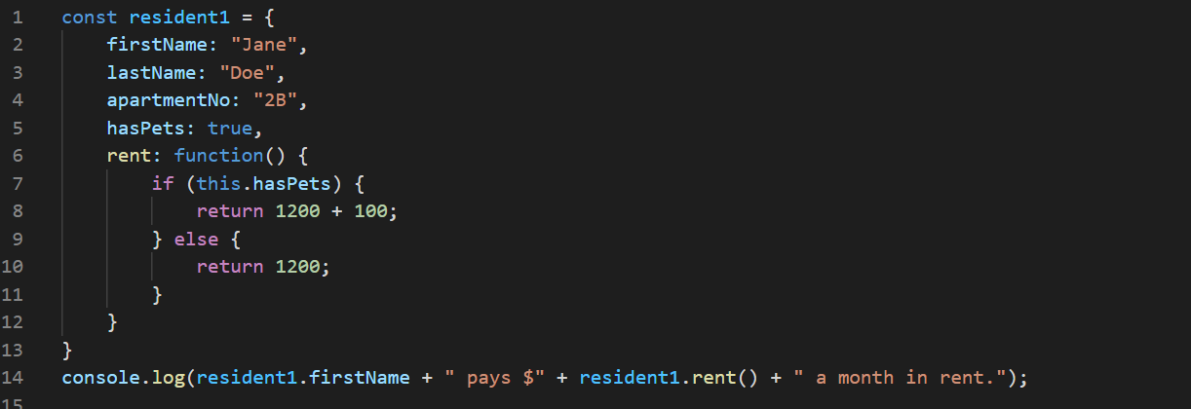
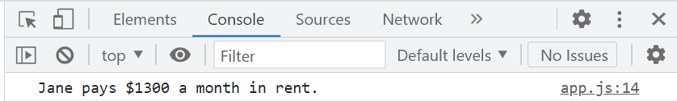
Objects
Creating objects

Slide 24
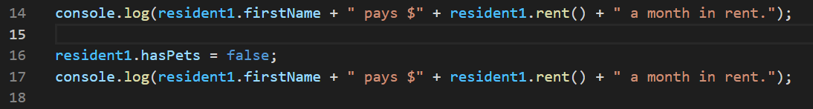
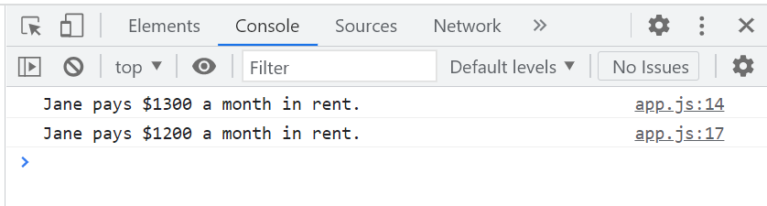
Objects
Changing object values

Slide 25
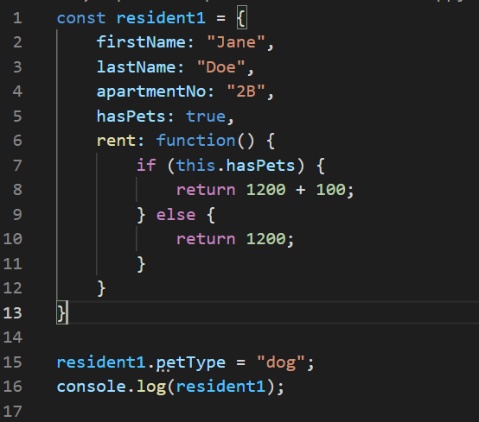
Objects
Adding properties

Slide 26
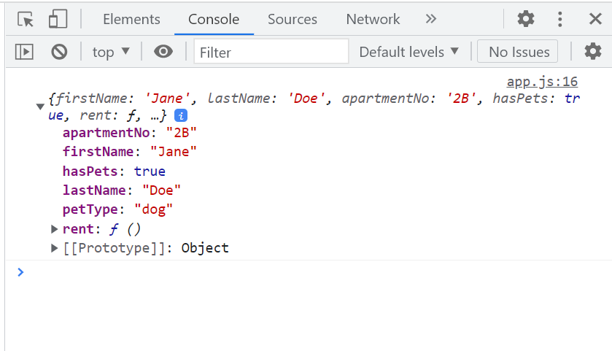
Objects
Adding new properties

